Slide 1

GIT – What is it?
It's used to share source code (Java code)
It can version the code to make merging and rolling back changes easy
You can develop code locally and push it to a remote server
Remember: It's for “source” control, not “any random crap I have in my directory” control

Slide 2
GIT – What is it?
Server
UI
New Page
Master
Client
Master
UI
My Test

Slide 3
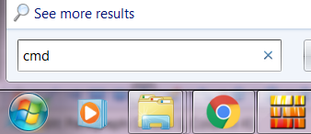
GIT – A Local repo
Click Start, enter “cmd” and press Enter

Slide 4
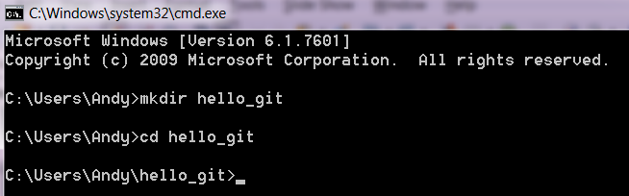
GIT – A Local repo
Create our repo
mkdir hello_git
cd hello_git

Slide 5
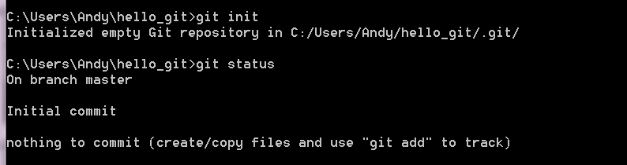
GIT – A Local repo
git init
git status

Slide 6
GIT – Who am I?
As GIT allows you to share code, you need to tell GIT who you are
We wouldn't want people to confuse the code that Rob writes with the code I write
git config --global user.email xxx
git config --global user.name xxx

Slide 7
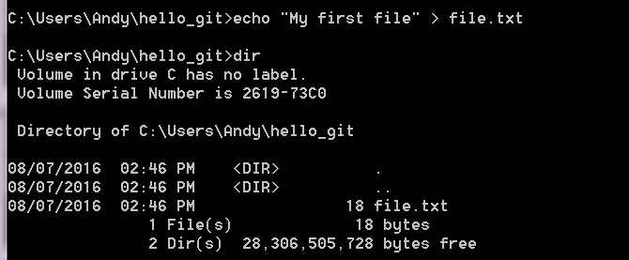
GIT – Adding content
echo “My first file” > file.txt

Slide 8
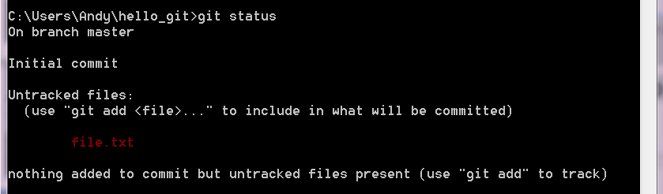
GIT – Adding content
We now have a file in the directory, but it is not versioned by GIT
We need to add the file to GIT
git status

Slide 9
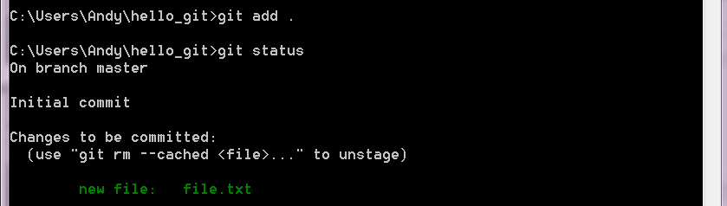
GIT – Adding content
We can add one file at a time, or add all of the files
git add .
git status

Slide 10

GIT – Adding content
Our file is now in GIT, but we have not “committed” our work, so currently it is not versioned
A “commit” takes a snapshot of the current files
git commit -m “I added a text file”

Slide 11
GIT - Branching
This is what GIT is all about
Branch for EVERYTHING
A branch is also called a feature, every feature you add to your program should be in its own branch
Branch and commit EVERYDAY (that you program)
A branch allows features to be added/removed easily and quickly. A big blob of 3 weeks of code is a PITA to merge

Slide 12
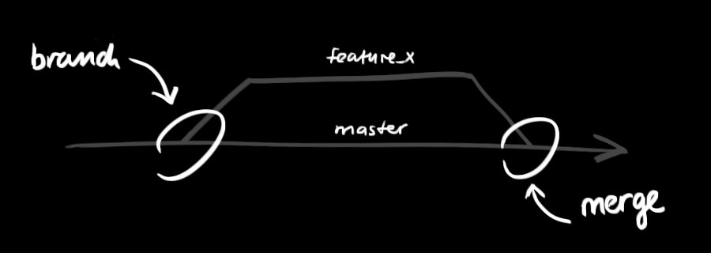
GIT - Branching
The “master” is the main code base
You create a branch to write/test your code
Then merge your branch when you're finished

Slide 13
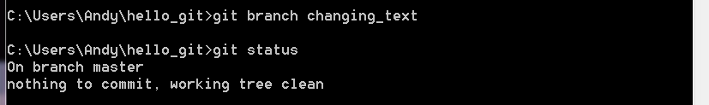
GIT - Branching
git branch changing_text
We created a branch, but we are not on it!
git status

Slide 14
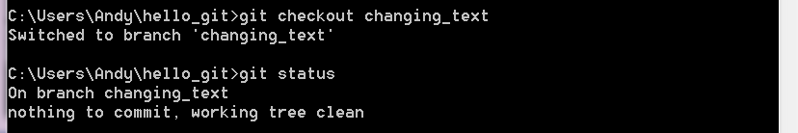
GIT - Checkout
Checkout changes the files on the disk to be the version that you checkout
git checkout changing_text
git status

Slide 15
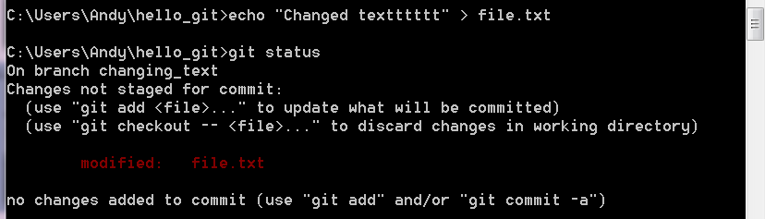
GIT – Change the file
echo "Changed textttttt" > file.txt
git status

Slide 16
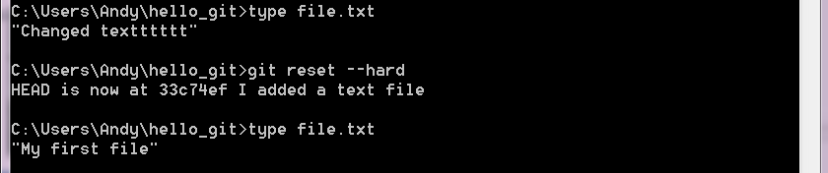
GIT - reset
I miss-typed, let's reset and try again
type file.txt
git reset –hard
type file.txt

Slide 17
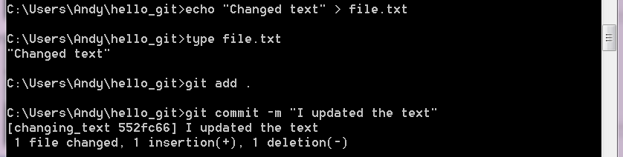
GIT - commit
Add the new files
Commit the changes (to THIS branch)
echo “Changed text” > file.txt
git add .
git commit -m “I updated the text”

Slide 18
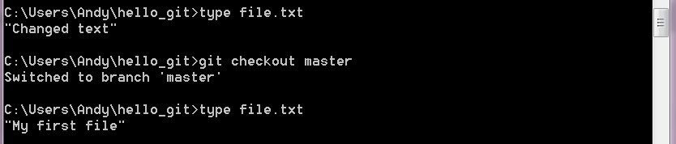
GIT – What is in the master?
The original content is still there. We only changed our branch
This allows us to develop
type file.txt
git checkout master
type file.txt

Slide 19
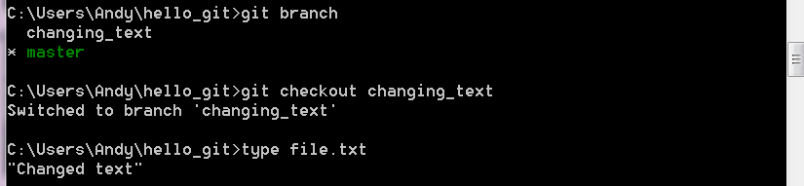
GIT – Where is our change?
Still in our branch
Err... what was the branch name?
git branch
git checkout changing_text
type file.txt

Slide 20
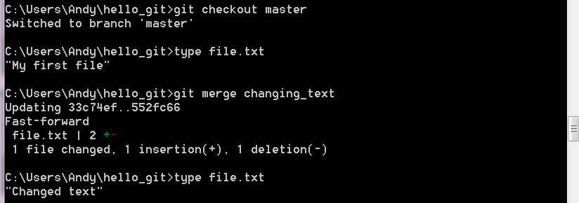
GIT – Merge our change
Checkout the branch you want to merge INTO
git checkout master
type file.txt
git merge <the other branch>
type file.txt

Slide 21
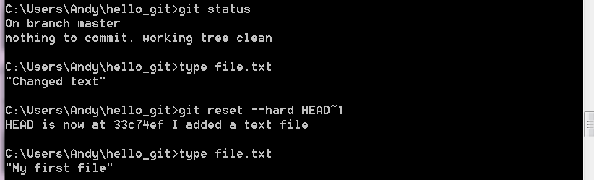
GIT – We need the old version!
I changed the text, but it's wrong
We can reset to old versions
~1 is 1 version back, we can rollback ~n

Slide 22
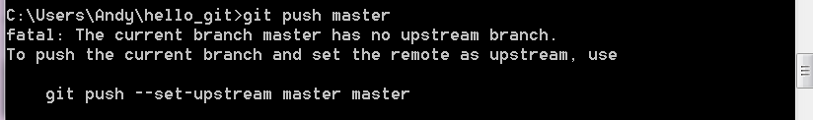
GIT – How to share code
My text file is so good everyone needs it
We need to push to a remote server
git push master
We don't have anywhere to push to...

Slide 23
GitHub to the rescue!
GitHub stores your code so that others can download it
It supports all of GIT's features
It has a UI to make merge etc. easier
You can push your own branches to it as a backup

Slide 24
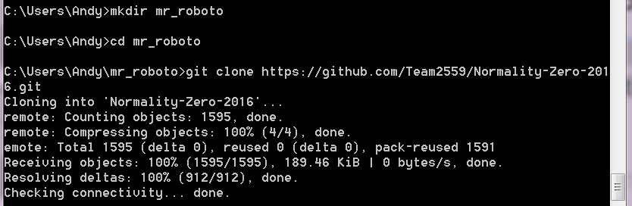
GIT – The Robot Project
Make a new directory
Clone the existing project into it
cd %HOMEPATH%
mkdir mr_roboto
git clone https://github.com/Team2559/Normality-Zero-2016.git

Slide 25
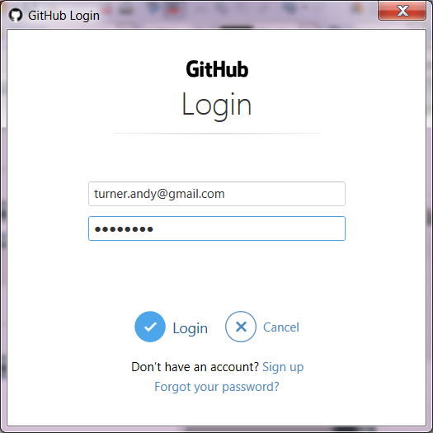
GIT – Don't want other to steal our code
Login to get the code

Slide 26
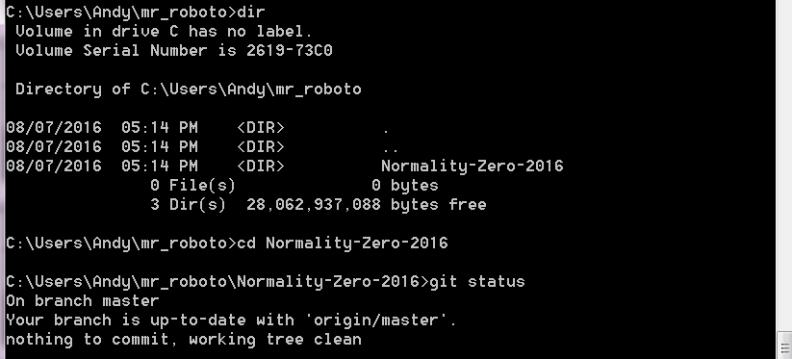
GIT – We have the robot code
We are currently on the master branch
cd Normality-Zero-2016
git status

Slide 27
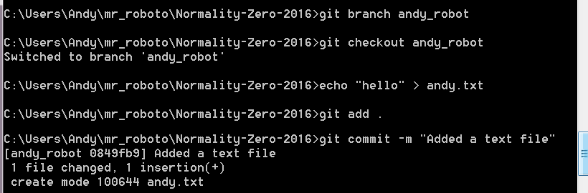
GIT – Let's add code to the robot
git branch andy_robot
git checkout andy_robot
echo “hello” > andy.txt
git add .
git commit -m “Added a text file”

Slide 28
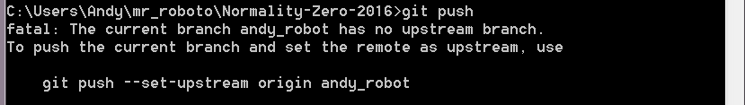
GIT – Now I can push my code!
- almost
git push
We tried to push to the remote server, but we didn't say what remote branch to put out local branch in

Slide 29
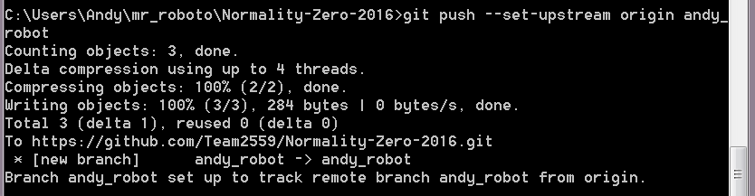
GIT - “upsteam” push
We want to push our local code “upstream” to the remote server
Generally call the remote branch the same as your local one
git push --set-upstream origin andy_robot

Slide 30
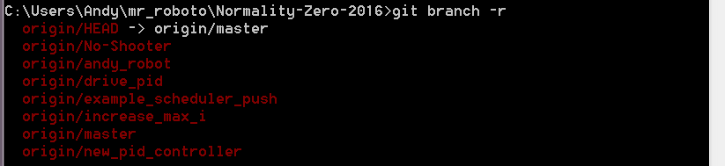
GIT – what branches?
git branch
  Only the local branches!
git branch -r

Slide 31
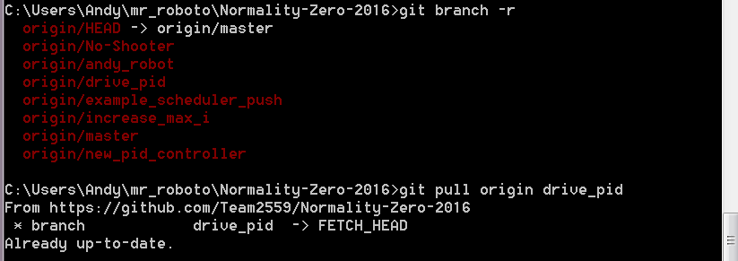
GIT - pull
If someone else “push”ed their code, we can “pull” their code to see what they did
git branch -r
git pull origin drive_pid
git branch

Slide 32
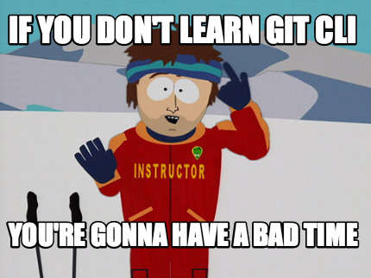
GIT - CLI

Slide 33
GIT - Eclipse
When Eclipse GIT gets stuck:
  Close Eclipse
  Fix GIT via the CLI
    Add/commit
    Rollback etc.
  Re-open Eclipse
  Refresh the project

Slide 34
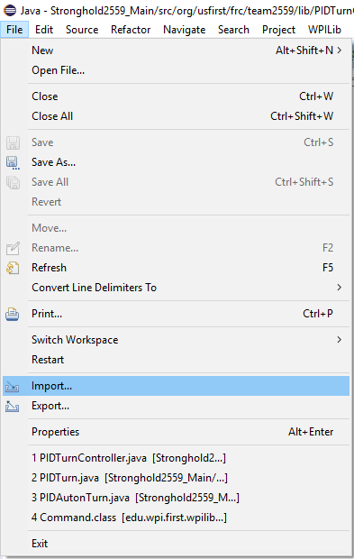
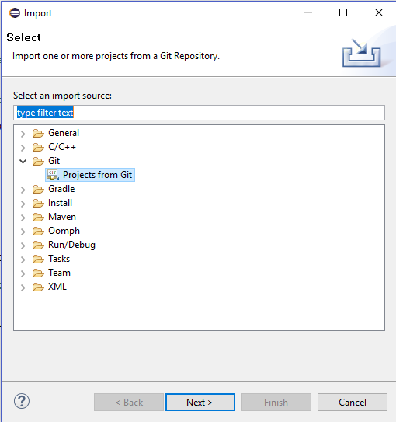
GIT - Eclipse
File > Import

Slide 35
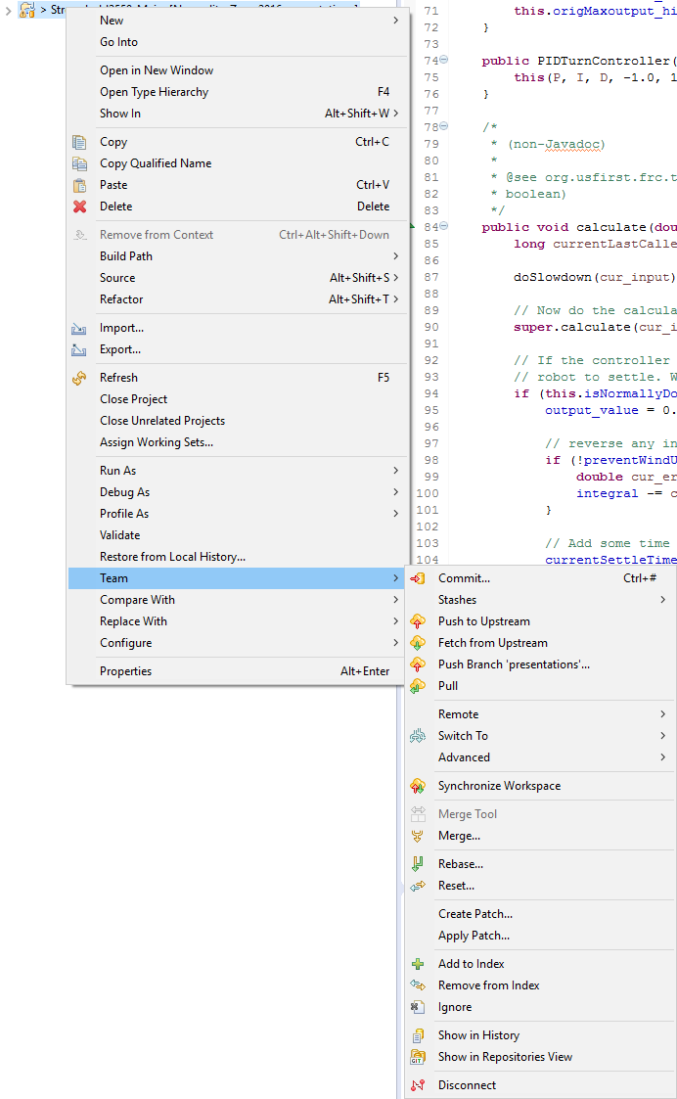
GIT - Eclipse
Right-click project
Team >

Slide 36
Conflict
If both you and someone else edit and commit the same line of code there will be a conflict
This is why it is best to branch, commit, and merge frequently
To fix a conflict you need to manually edit each conflict and choose the code that you want to commit
  That's why it's best avoided
https://help.github.com/articles/resolving-a-merge-conflict-from-the-command-line/

Slide 37
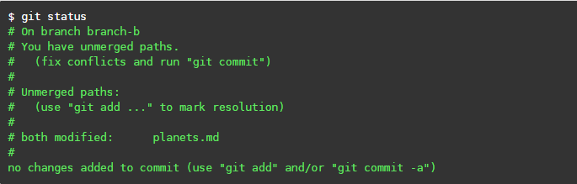
Conflict

Slide 38
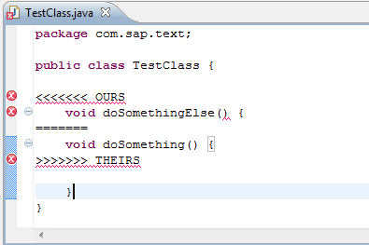
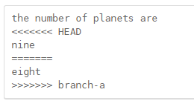
Conflict

